Slide 1

THE BATTLE FOR THE MIND & BODY
Warfare Series 5

Slide 2
introduction
This is a very important session in our series as we now delve deeper into why Christians experience warfare, failure and disappointments despite the complete victory and supremacy of Christ.
We will not postulate but allow the Scriptures themselves to answer these puzzling questions and realities.

Slide 3
INTRODUCTION
The decision to use a black and white contrast in this presentation is intentional as it depicts the struggle going on internally as Christians grapple with the reality of Christ in us versus sinful tendencies in our bodies and souls.
This wrestling is very real but should not becloud or undermine the reality of our spiritual posture in Christ and the support of the Holy Spirit within us.

Slide 4
Reasons for oppression
Religion versus Relationship
Go to Church but don’t have the Word
Superstitious and open to many fears and deception
Mental breakdown
Lifestyle opens doors for the enemy
Do not know their authority and being bullied by demons
Some do need prayer and deliverance

Slide 5
REMINDERS
Christ is Supreme
The Devil has been defeated
We are seated with Christ in the Heavenlies
We are spirit, with a soul and living in a physical body
The Spirit of Christ is within us; joined with our spirit.

Slide 6

WE ARE SPIRIT…
⁶ That which is born of the flesh is flesh [the physical is merely physical], and that which is born of the Spirit is spirit
John 3:6

Slide 7
WITH A SOUL….and body
¹² For the word of God is living and powerful, and sharper than any two-edged sword, piercing even to the division of soul and spirit, and of joints and marrow, and is a discerner of the thoughts and intents of the heart
Hebrews 4:12

Slide 8
Spirit means pneuma
⁹ But you are not in the flesh but in pnuema, if indeed pnuema of God dwells in you. Now if anyone does not have pnuema of Christ, he is not His. ¹⁰ And if Christ is in you, the body is dead because of sin, but pnuema is life because of righteousness.
Romans 8:9-10

Slide 9
Spirit means pneuma
¹⁶ The pneuma Himself bears witness with our pneuma that we are children of God,
Romans 8:16

Slide 10
The internal conflict
²² For I joyfully delight in the law of God in my inner self [with my new nature], ²³ but I see a different law and rule of action in the members of my body [in its appetites and desires], waging war against the law of my mind and subduing me and making me a prisoner of the law of sin which is within my members
Romans 7:22-23

Slide 11
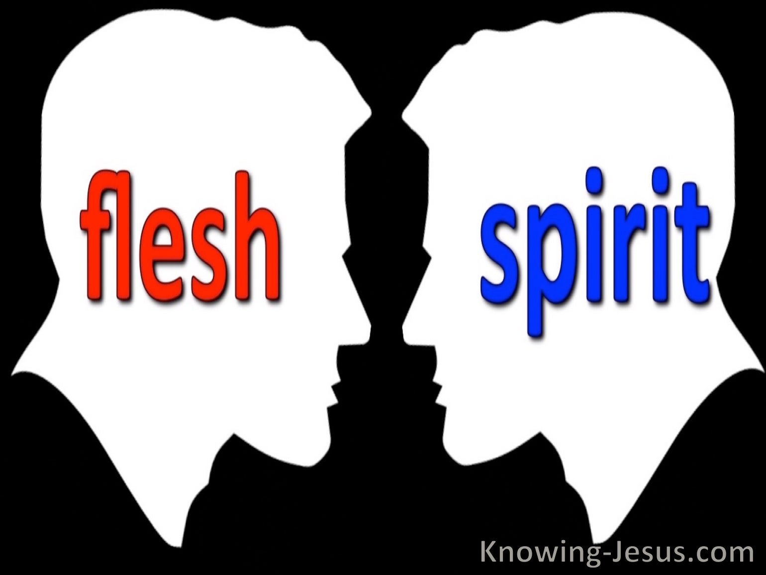
The internal conflict

Slide 12
Pneuma versus flesh
¹⁶ I say then: Walk in pneuma, and you shall not fulfill the lust of the flesh. ¹⁷ For the flesh lusts against pneuma, and pneuma against the flesh; and these are contrary to one another, so that you do not do the things that you wish.
Galatians 5:16-17

Slide 13
Pneuma versus flesh
⁴¹ Watch and pray, lest you enter into temptation. Pneuma indeed is willing, but the flesh is weak.”
Matthew 26:41

Slide 14

Watch…
Give attention
Be cautious
Active
Alert
Watchful
Take heed
Be discerning

Slide 15
Watch….
⁸ Be sober [well balanced and self-disciplined], be alert and cautious at all times. That enemy of yours, the devil, prowls around like a roaring lion [fiercely hungry], seeking someone to devour.
1 Peter 5:8

Slide 16
The first battle…
The crucial first war to win technically has nothing to do with the devil or demons. Many, believers confuse this with demonic warfare when it isn’t.
²³ but I see a different law and rule of action in the members of my body [in its appetites and desires], waging war against the law of my mind and subduing me and making me a prisoner of the law of sin which is within my members
Romans 7:22-23

Slide 17
The first battle…
The key to victory here is to overcome the ‘dominance’ of the flesh or sinful nature by the strength of the New Man or your spirit:
because if you live according to the flesh, you are going to die. But if by pneuma you put to death the deeds of the body, you will live.
Romans 8:13 CSB

Slide 18
The first battle…
⁸ But now rid yourselves [completely] of all these things: anger, rage, malice, slander, and obscene (abusive, filthy, vulgar) language from your mouth. ⁹ Do not lie to one another, for you have stripped off the old self with its evil practices,
¹⁰ and have put on the new [spiritual] self who is being continually renewed in true knowledge in the image of Him who created the new self
Colossians 3:8-10

Slide 19
The next battle
One of the key tactics of the devil is to use the ‘Trojan Horse’ of our flesh to lure and entice us, this is called Temptation:
¹³ Let no one say when he is tempted, “I am tempted by God”; for God cannot be tempted by evil, nor does He Himself tempt anyone. ¹⁴ But each one is tempted when he is drawn away by his own desires and enticed. ¹⁵ Then, when desire has conceived, it gives birth to sin; and sin, when it is full-grown, brings forth death
James 1:13-15

Slide 20
The next battle
Note that these flesh desires are not necessarily wrong or evil but they must be put in check. Remember Jesus Christ as a Man was tempted by the devil
Then Jesus was led up by the Spirit into the wilderness to be tempted by the devil. ² And when He had fasted forty days and forty nights, afterward He was hungry. ³ Now when the tempter came to Him, he said, “If You are the Son of God, command that these stones become bread.”
⁴ But He answered and said, “It is written, ‘Man shall not live by bread alone, but by every word that proceeds from the mouth of God.’
Matthew 4

Slide 21
Trojan…(open doors)
¹⁹ Now the practices of the sinful nature are clearly evident: they are sexual immorality, impurity, sensuality (total irresponsibility, lack of self-control),
²⁰ idolatry, sorcery, hostility, strife, jealousy, fits of anger, disputes, dissensions, factions [that promote heresies],
²¹ envy, drunkenness, riotous behavior, and other things like these.
Galatians 5:19-21

Slide 22
Open doors to the enemy
Gnawing worry
Fear & Terror
Violence & Anger
Intense Swearing
Lustful visuals
Excessive eating
Unforgiveness & Malice
Magic and Sorcery
Superstition
Idolatry & Carnality

Slide 23
3 major keys for victory
Dominate Your Flesh
1
Reduce Temptation
2
Cast out devils
3

Slide 24
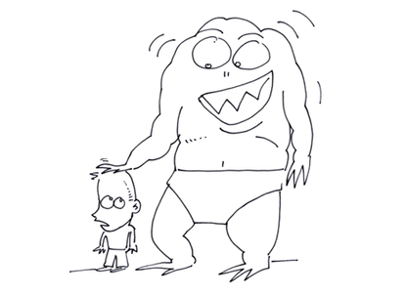
Dominate the flesh
27 But [like a boxer] I strictly discipline my body and make it my slave, so that, after I have preached [the gospel] to others, I myself will not somehow be disqualified [as unfit for service]
1 Corinthians 9:27

Slide 25

Reduce temptation..
‘And do not lead us into temptation but deliver us from evil. Matthew 6:13
21 Test all things; hold fast what is good. 22 Abstain from every form of evil. 1 Thess 5:22

Slide 26
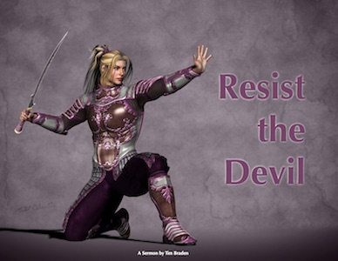
Cast out devils
Therefore, submit to God.
Resist the devil and he will flee from you
James 4:7

Slide 27
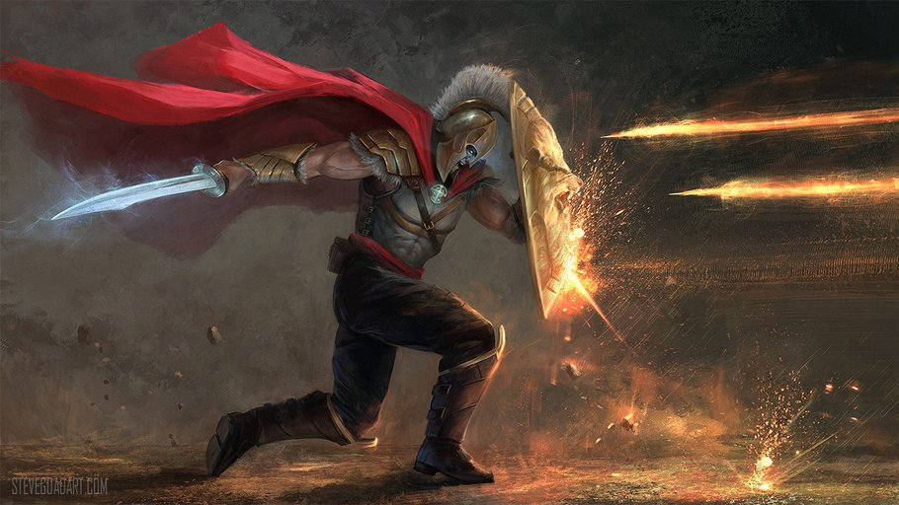
How to totally overcome satan

