Slide 1
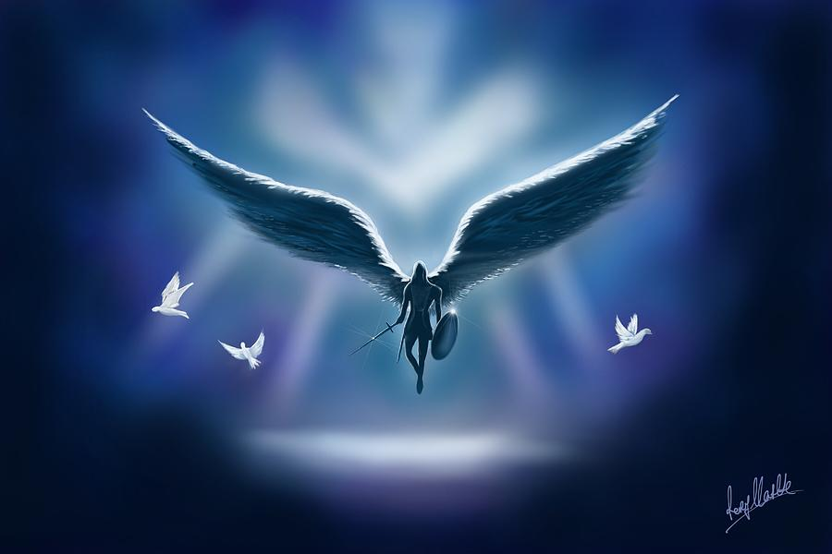
MINISTRY OF ANGELS

Slide 2
INTRODUCTION
We are now moving deeper into our study of the invisible world and spiritual warfare.
This session will examine the reality of Angels, their nature, roles and spiritual function as dictated by scripture and not myth or church culture.
Please note that we will be looking at Angels in the context of spiritual warfare. This is not a comprehensive study of Angels in whole entirety. You can use the Blue Letter Bible App for that.

Slide 3

Malak & Angelos
And the elders of Jabesh said unto him, Give us seven days' respite, that we may send messengers unto all the coasts of Israel: and then, if there be no man to save us, we will come out to thee.
1 Samuel 11:3
And when the messengers of John were departed, he began to speak unto the people concerning John, What went ye out into the wilderness for to see? A reed shaken with the wind?
Luke 7:24

Slide 4
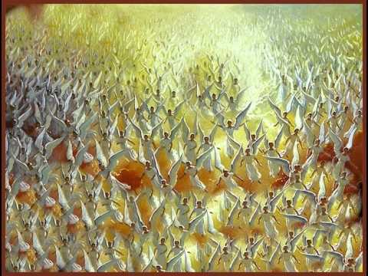
UNCOUNTABLE
²² But you have come to Mount Zion and to the city of the living God, the heavenly Jerusalem, to an innumerable company of angels,
Hebrews 12:22

Slide 5
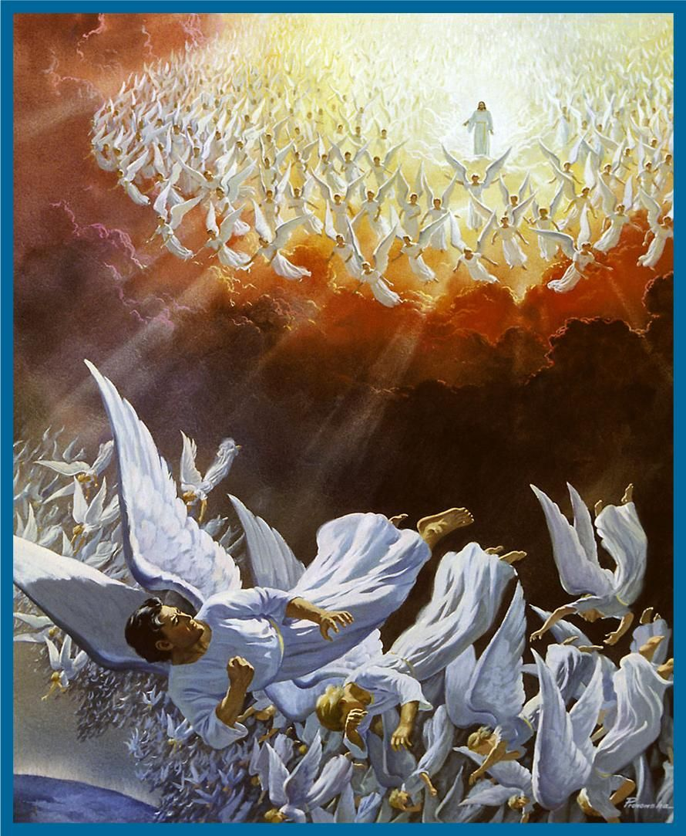
STRONGER THAN SATAN
⁷ And war broke out in heaven: Michael and his angels fought with the dragon; and the dragon and his angels fought, ⁸ but they ^{[a]}did not prevail, nor was a place found for ^{[b]}them in heaven any longer. ⁹ So the great dragon was cast out, that serpent of old, called the Devil and Satan, who deceives the whole world; he was cast to the earth, and his angels were cast out with him.
Revelation 12:7-9

Slide 6
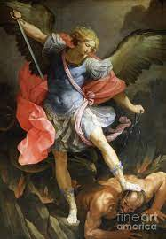
STRONGER….
Then I saw an angel coming down from heaven, having the key to the bottomless pit and a great chain in his hand. ² He laid hold of the dragon, that serpent of old, who is the Devil and Satan, and bound him for a thousand years; ³ and he cast him into the bottomless pit, and shut him up
Revelation 20:1-3

Slide 7
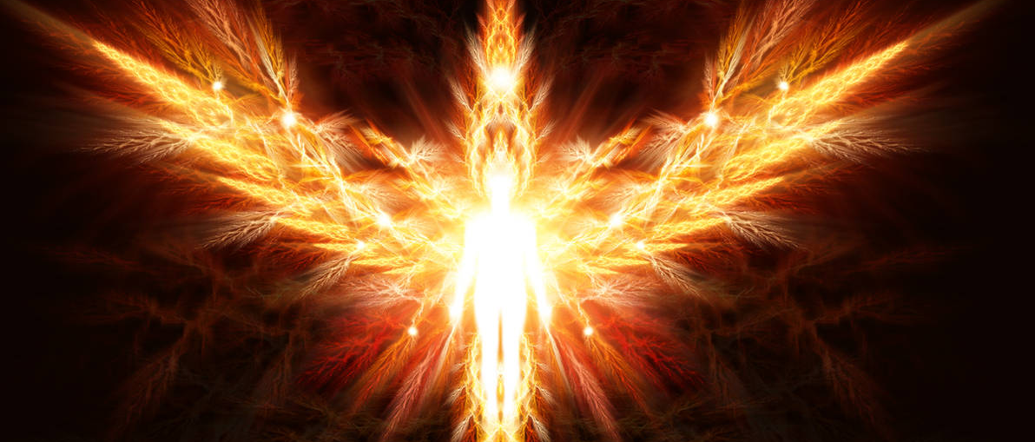
FLAMING SPIRITS
⁷ And of the angels He says:
“Who makes His angels spirits And His ministers a flame of fire.” Hebrews 1:7

Slide 8
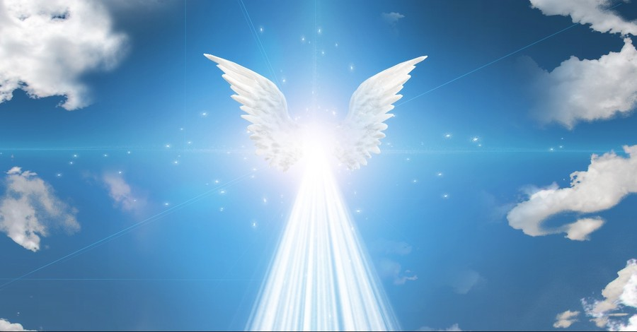
Messenger of God
⁷ Now the Angel of the Lord found her by a spring of water in the wilderness, by the spring on the way to Shur. ⁸ And He said, “Hagar, Sarai’s maid, where have you come from, and where are you going?”
She said, “I am fleeing from the presence of my mistress Sarai.”
⁹ The Angel of the Lord said to her, “Return to your mistress, and submit yourself under her hand.” ¹⁰ Then the Angel of the Lord said to her, “I will multiply your descendants exceedingly, so that they shall not be counted for multitude.”

Slide 9
Messenger of God
¹¹ And the Angel of the Lord said to her:
“Behold, you are with child,
And you shall bear a son.
You shall call his name ^{[d]}Ishmael,
Because the Lord has heard your affliction.
¹² He shall be a wild man;
His hand shall be against every man,
And every man’s hand against him.
And he shall dwell in the presence of all his brethren.”
¹³ Then she called the name of the Lord who spoke to her, You-Are-^{[e]}the-God-Who-Sees; for she said, “Have I also here ^{[f]}seen Him who sees me?”
Genesis 16:7-13

Slide 10
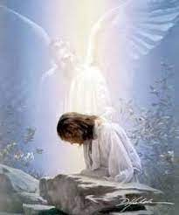
Guardian Angel
For He shall give His angels charge over you,
To keep you in all your ways
Psalm 91
The term guardian Angel is not in the Bible but it is implied.

Slide 11
Guardian Angel
¹⁰ “Take heed that you do not despise one of these little ones, for I say to you that in heaven their angels always see the face of My Father who is in heaven. ¹¹ For^{[c]} the Son of Man has come to save that which was lost.
Matthew 18:10

Slide 12
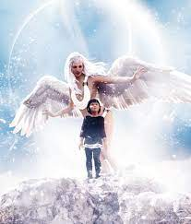
GUARDIAN ANGEL
He shall cover you with His feathers,
And under His wings you shall take refuge;
His truth shall be your shield and buckler.
Psalm 91:4

Slide 13
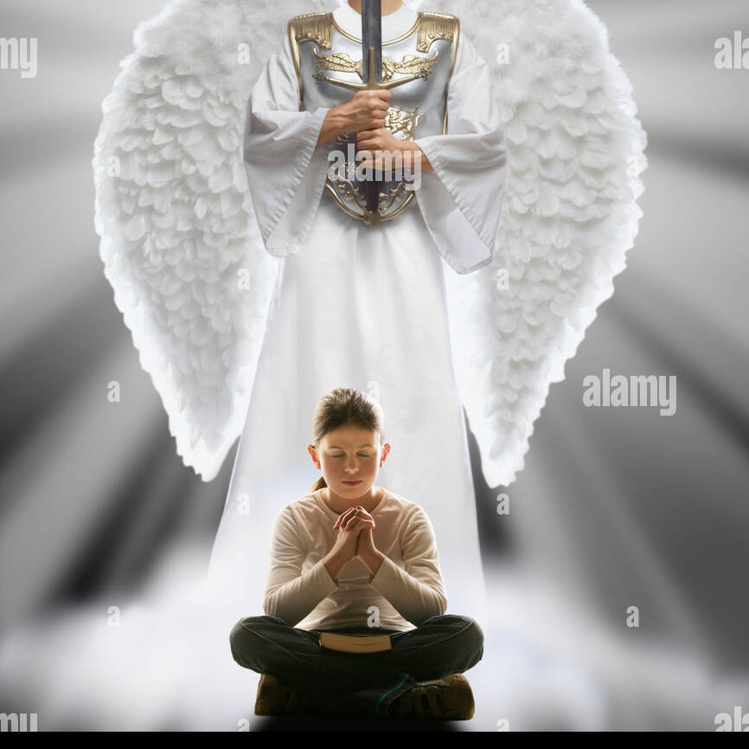
MINISTERING ANGEL
¹⁴ Are not all the angels' ministering spirits sent out [by God] to serve (accompany, protect) those who will inherit salvation? Hebrews 1:14

Slide 14
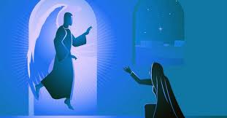
MINISTERING ANGEL
²⁶ Now in the sixth month [of Elizabeth’s pregnancy] the angel Gabriel was sent from God to a city in Galilee called Nazareth, ²⁷ to a virgin ^{[j]}betrothed to a man whose name was Joseph, a descendant of the house of David; and the virgin’s name was Mary. ²⁸ And coming to her, the angel said, “Greetings, favored one! The Lord is with you.”
Luke 1:26-28

Slide 15
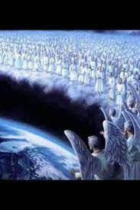
DELIVERANCE
The angel of the LORD encamps all around those who fear Him,
And delivers them
Psalm 34:7

Slide 16
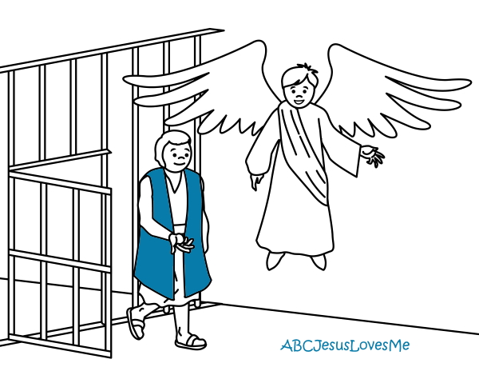
DELIVERANCE
But at night an angel of the Lord opened the prison doors and brought them out, and said,
“Go, stand in the temple and speak to the people all the words of this life.”
Acts 5:19-20

Slide 17
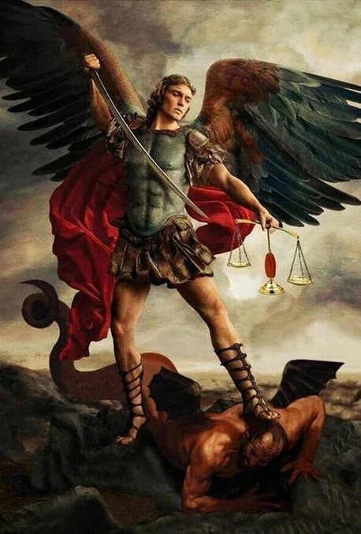
VICTORY
For He shall give His angels charge over you,
To keep you in all your ways.
¹² In their hands they shall ^{[c]}bear you up,
Lest you ^{[d]}dash your foot against a stone.
¹³ You shall tread upon the lion and the cobra,
The young lion and the serpent you shall trample underfoot.
Psalm 91

Slide 18
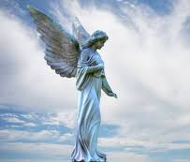
GUIDANCE
²⁶ Now an angel of the Lord spoke to Philip, saying, “Arise and go toward the south along the road which goes down from Jerusalem to Gaza.” This is ^{[e]}desert. ²⁷ So he arose and went.
Acts 8:26

Slide 19
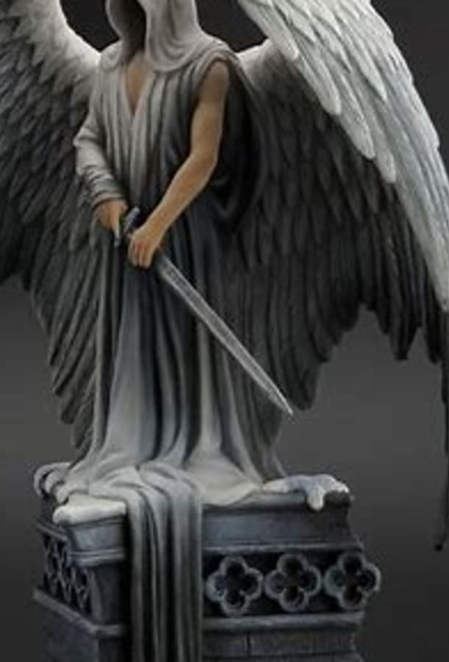
JUDGEMENT
²¹ So on a set day Herod, arrayed in royal apparel, sat on his throne and gave an oration to them. ²² And the people kept shouting, “The voice of a god and not of a man!” ²³ Then immediately an angel of the Lord struck him, because he did not give glory to God. And he was eaten by worms and ^{[g]}died.
²⁴ But the word of God grew and multiplied.
Acts 12:21-24

Slide 20
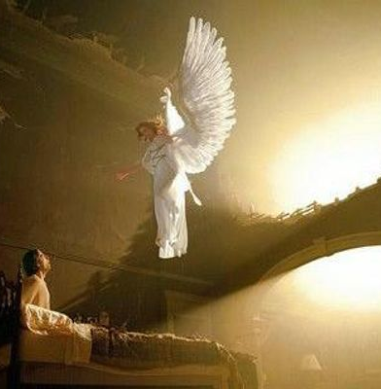
DREAMS
²⁰ But while he thought about these things, behold, an angel of the Lord appeared to him in a dream, saying, “Joseph, son of David, do not be afraid to take to you Mary your wife, for that which is ^{[g]}conceived in her is of the Holy Spirit.
Matthew 1:20

Slide 21
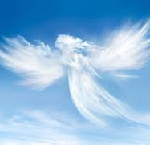
VISIONS
³ About ^{[c]}the ninth hour of the day he saw clearly in a vision an angel of God coming in and saying to him, “Cornelius!”
⁴ And when he observed him, he was afraid, and said, “What is it, lord?”
So he said to him, “Your prayers and your alms have come up for a memorial before God
Acts 10:3

Slide 22

STRENGTH
¹¹ Then the devil left Him, and behold, angels came and ministered to Him.
Matthew 4:11
^{43 [f]}Then an angel appeared to Him from heaven, strengthening Him. ⁴⁴ And being in agony, He prayed more earnestly. Then His sweat became like great drops of blood falling down to the ground.
Luke 22:43

Slide 23
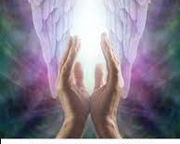
PRAYER
³ Then another angel, having a golden censer, came and stood at the altar. He was given much incense, that he should offer it with the prayers of all the saints upon the golden altar which was before the throne. ⁴ And the smoke of the incense, with the prayers of the saints, ascended before God from the angel’s hand. ⁵ Then the angel took the censer, filled it with fire from the altar, and threw it to the earth. And there were noises, thunderings, lightnings, and an earthquake.
Revelation 8:3-5

Slide 24
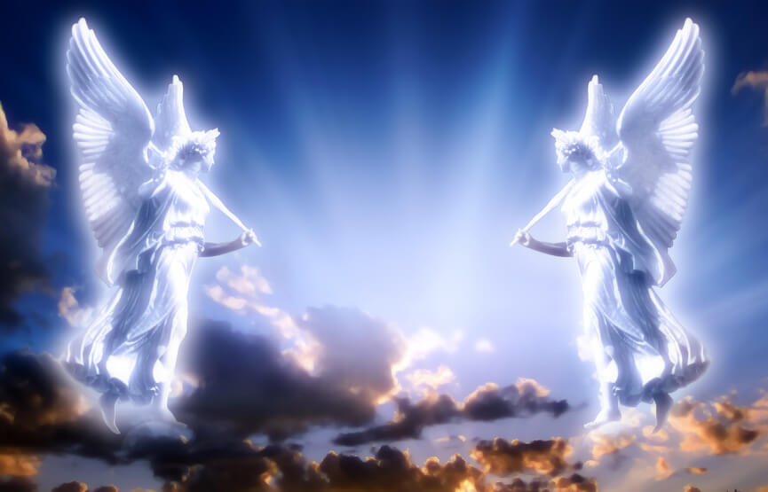
PRAYER RESPONSE
⁵ Peter was therefore kept in prison, but ^{[b]}constant prayer was offered to God for him by the church. ⁶ And when Herod was about to bring him out, that night Peter was sleeping, bound with two chains between two soldiers; and the guards before the door were ^{[c]}keeping the prison. ⁷ Now behold, an angel of the Lord stood by him, and a light shone in the prison; and he struck Peter on the side and raised him up, saying, “Arise quickly!” And his chains fell off his hands
Acts 12:5-7

Slide 25
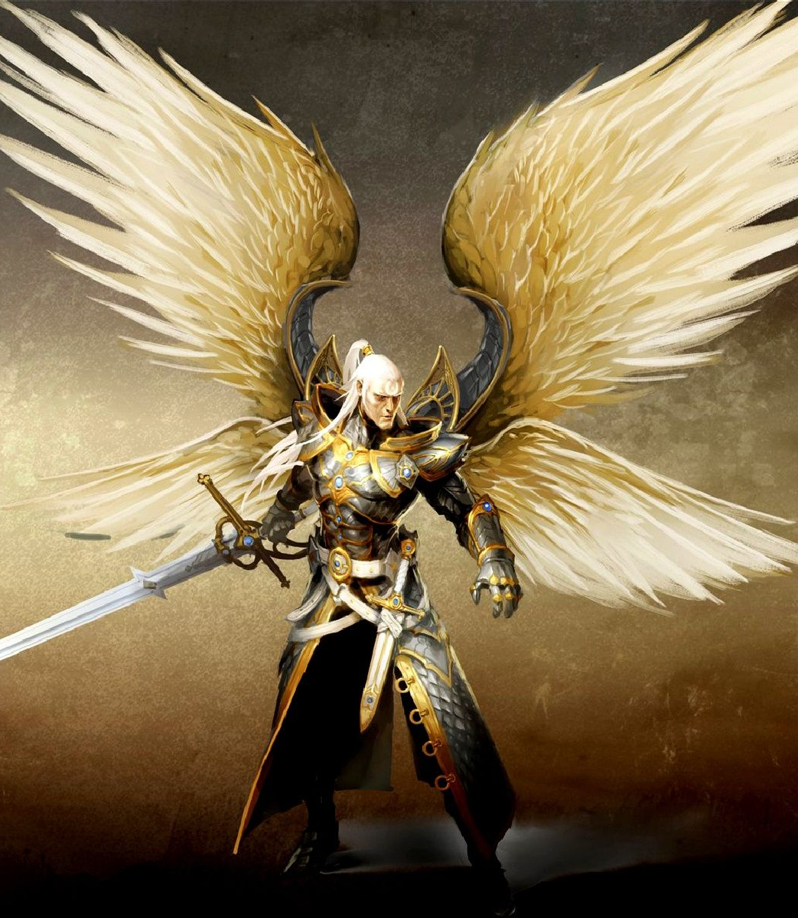
WORD PERFECT
You divine messengers, bless the Lord! You who are mighty in power and keep his word, who obey everything he says, bless him! CEB
Bless the Lord, ye His angels that excel in strength, that do His commandments, hearkening unto the voice of His word. KJV
Psalm 103:20

Slide 26
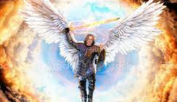
Closing Statements
Angels can communicate with us
We can communicate with Angels
We do NOT command Angels
We do NOT pray to Angels
Angelic encounters do NOT override the Word of God
We should be more Angels aware than demonic conscious
More are they for us than those against us

