Slide 1
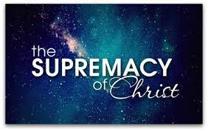
SPIRITUAL WARFARE SERIES
The Supremacy of Christ

Slide 2
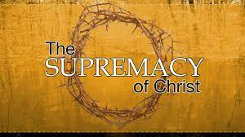
The Supremacy of Christ
As we start this new series to explore the spiritual world, the devil, demons and the battle within everyone, there is only one place to start and that is CHRIST!
This is because He is the beginning and the end; ALPHA & OMEGA

Slide 3

SPIRITUAL WARFARE
IF YOU DON’T HAVE A PROPER VIEW OF JESUS CHRIST, YOU WILL HAVE A WRONG PICTURE OF SATAN.
Incomplete Christology produces exaggerated Demonology.

Slide 4
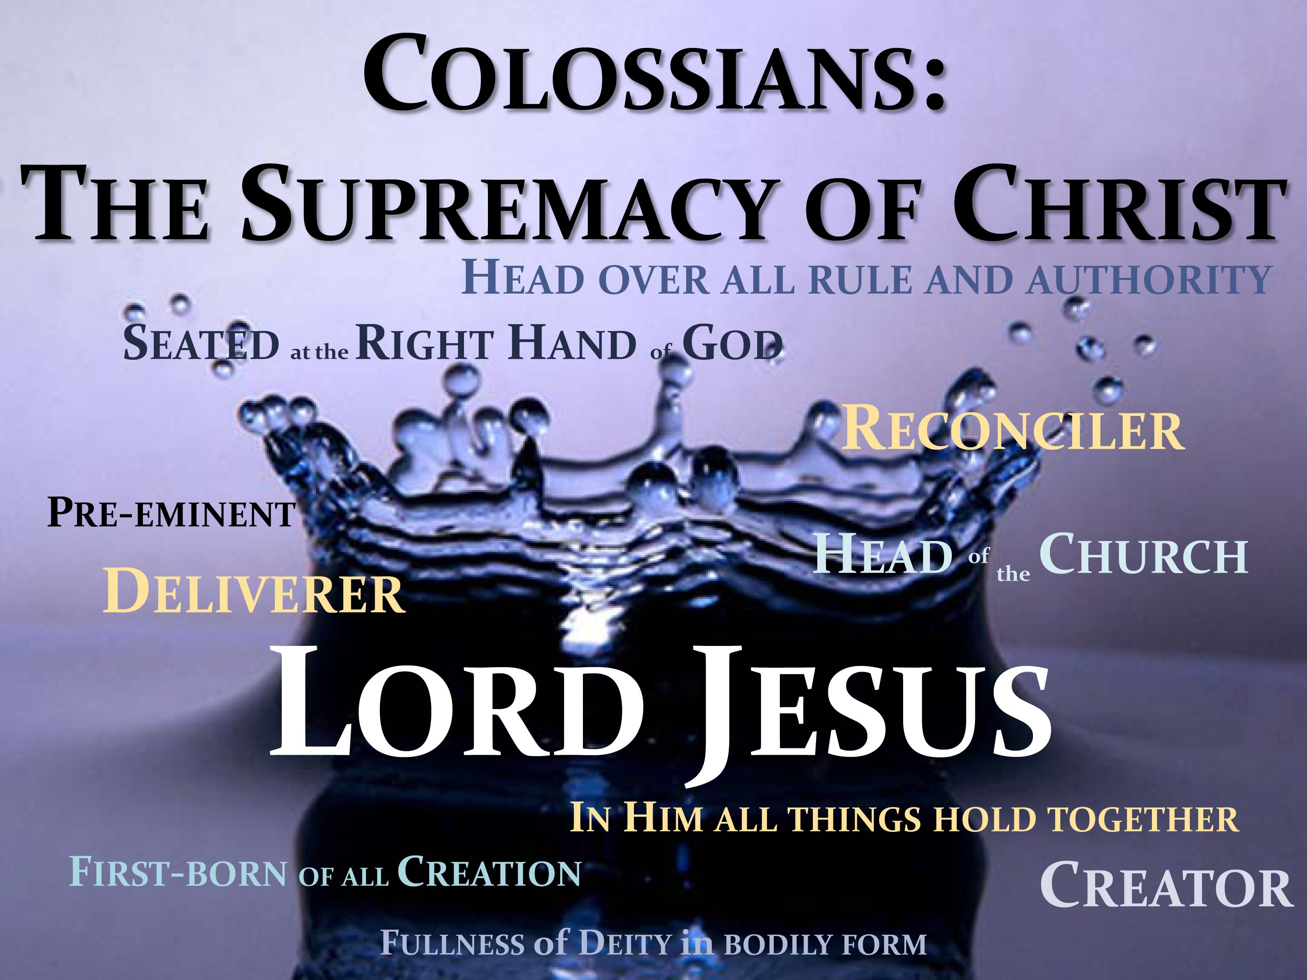
The Supremacy of Christ
Colossians Chapter One

Slide 5
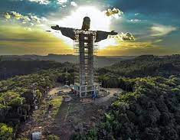
CHRIST THE REDEEMER
¹⁴ in whom we have redemption [because of His sacrifice, resulting in] the forgiveness of our sins [and the cancellation of sins’ penalty. Colossians 1:14

Slide 6
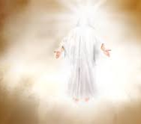

THE COMPLETE DELIVERER
¹³ For He has rescued us and has drawn us to Himself from the dominion of darkness and has transferred us to the kingdom of His beloved Son,]. Colossians 1:13

Slide 7
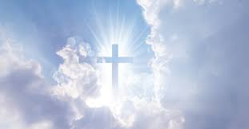
CHRIST IS GOD
¹⁵ He is the exact living image [the essential manifestation] of the unseen God [the visible representation of the invisible], the firstborn [the preeminent one, the sovereign, and the originator] of all creation.
Colossians 1:15

Slide 8
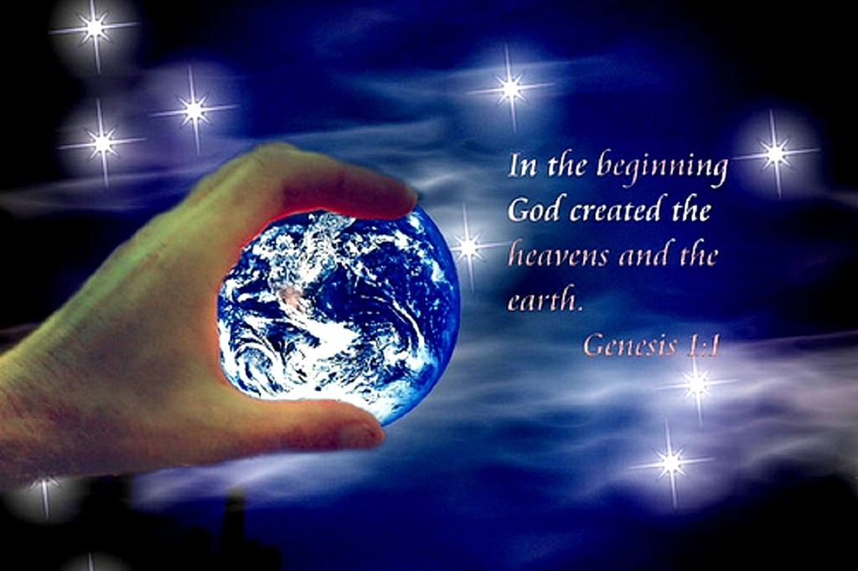
CHRIST THE CREATOR
¹⁶ For ^{[d]}by Him all things were created in heaven and on earth, [things] visible and invisible, whether thrones or dominions or rulers or authorities; all things were created and exist through Him [that is, by His activity] and for Him.

Slide 9
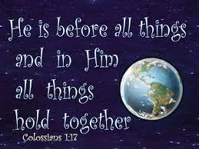
CHRIST BEFORE ALL….
¹⁷ And He Himself existed and is before all things, and in Him all things hold together. [His is the controlling, cohesive force of the universe.]
Colossians 1:17

Slide 10
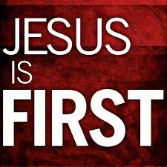
CHRIST IS FIRST.
¹⁸ He is also the head [the life-source and leader] of the body, the ^{[e]}church; and He is the beginning, ^{[f]}the firstborn from the dead, so that He Himself will occupy the first place [He will stand supreme and be preeminent] in everything. Colossians 1:18

Slide 11

CHRIST IS FULLY GOD
¹⁹ For it pleased the Father for all the fullness [of deity—the sum total of His essence, all His perfection, powers, and attributes] to dwell [permanently] in Him (the Son), Colossians 1:19

Slide 12
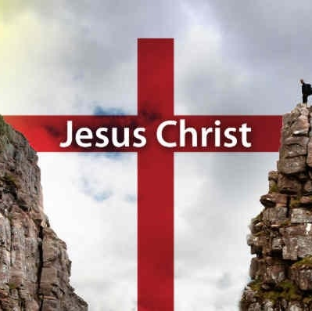
CHRIST THE RECONCILER OF ALL THINGS!
²⁰ and through [the intervention of] the Son to reconcile all things to Himself, making peace [with believers] through the blood of His cross; through Him, [I say,] whether things on earth or things in heaven.

Slide 13
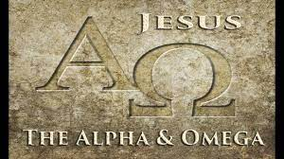
CHRIST IS ALPHA AND OMEGA
I am the Alpha and the Omega, the First and the Last, the Beginning and the End [the Eternal One].
Revelation 22:13

Slide 14

CHRIST IS THE BEGINNING & END
“I am the Alpha and the Omega [the Beginning and the End],” says the Lord God, “Who is [existing forever] and Who was [continually existing in the past] and Who is to come, the Almighty [the Omnipotent, the Ruler of all].
Revelation 1:8

Slide 15
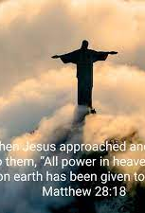
CHRIST IS ALL POWERFUL…
¹⁸ Jesus came up and said to them, “All authority (all power of absolute rule) in heaven and on earth has been given to Me. Matthew 28:18

Slide 16

THE SUPREMACY OF CHRIST!!

