Slide 1
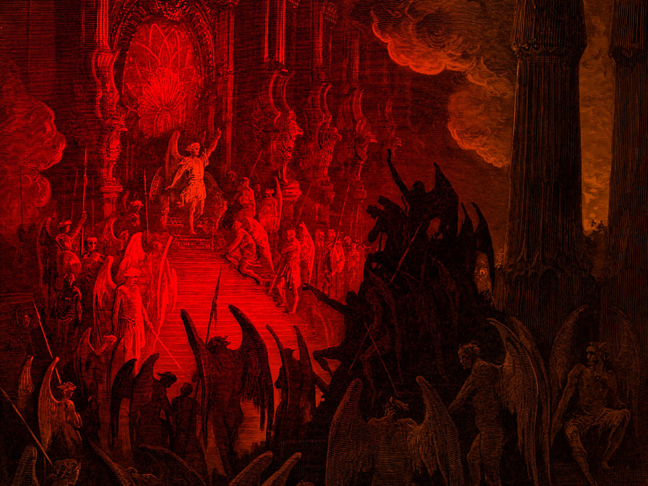
How Powerful Is Satan?
Warfare Series

Slide 2
How Powerful is the Devil?
We will use this session to examine the extent of Satan's authority or power. This is important in the scheme of things as we unpack the spiritual world versus the physical world, we live in.

Slide 3

Fall of Lucifer
“How you are fallen from Heaven, O Lucifer, son of the morning! How you are cut down to the ground, you who weakened the nations! For you have said in your heart: ‘I will ascend into Heaven, I will exalt my throne above the stars of God; I will also sit on the mount of the congregation on the farthest sides of the north; I will ascend above the heights of the clouds, I will be like the Most High.’ Yet you shall be brought down to Sheol, to the lowest depths of the Pit” (Isaiah 14:12–15).

Slide 4
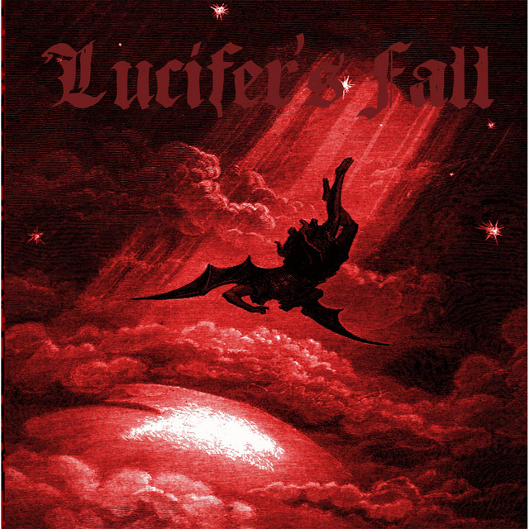
Fall of Satan
⁵ For God knows that on the day you eat from it your eyes will be opened [that is, you will have greater awareness], and you will be like God, knowing [the difference between] good and evil

Slide 5
Fall Of Lucifer
Lucifer fell from Heaven
He was cast down to the ground
His modus was to weaken nations.
He said in his heart…origin of evil or sin
I will be like the most High – origin of Lucifer’s fall

Slide 6
Guardian Cherub
“You were the model of perfection, full of wisdom and perfect in beauty. You were in Eden, the garden of God…You were anointed as a guardian cherub, for so I ordained you. You were on the holy mount of God; you walked among the fiery stones. You were blameless in your ways from the day you were created till wickedness was found in you. Through your widespread trade you were filled with violence, and you sinned. So, I drove you in disgrace from the mount of God, and I expelled you, O guardian cherub, from among the fiery stones. Your heart became proud on account of your beauty, and you corrupted your wisdom because of your splendor. So, I threw you to earth; I made a spectacle of you before kings”
(Ezekiel 28:12–17 NIV).

Slide 7
Serpent Called Satan
So, the great dragon was cast out, that serpent of old, called the Devil and Satan, who deceives the whole world; he was cast to the earth, and his angels were cast out with him.

Slide 8

Fallen Angel
In Summary, Lucifer was created by God as a specimen of splendor and great beauty.
Sometime long ago, he decided in his heart to go beyond his station and attempt to become like God Himself.
This led to his downfall

Slide 9
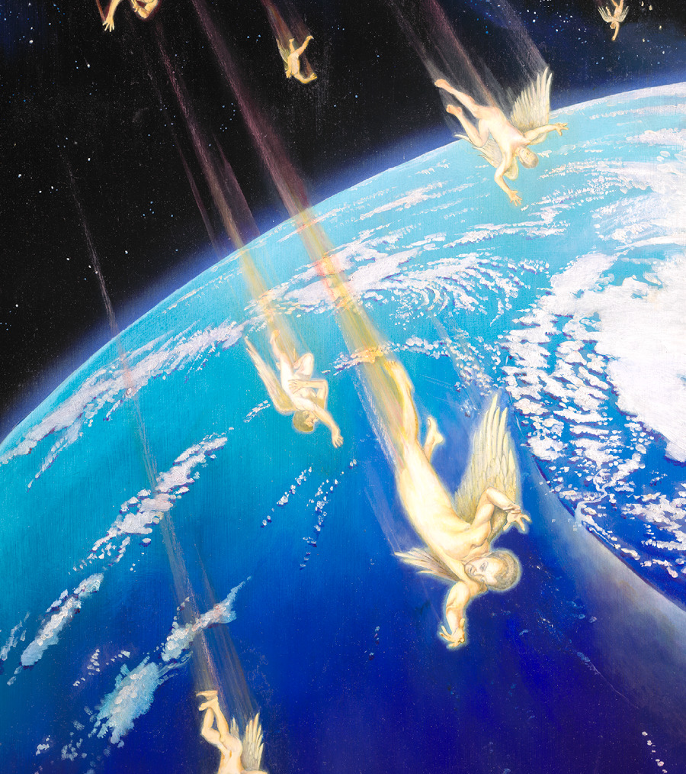
Lucifer Fell with other angels.
⁹ And the great dragon was thrown down, the age-old serpent who is called the ^{[d]}devil and Satan, he who continually deceives and seduces the entire inhabited world; he was thrown down to the earth, and his angels were thrown down with him. Revelation 12:9

Slide 10

The Book of Job
Let us now look at a classic scripture text that shows the interaction between Satan and God
⁶ Now there was a day when the sons of God came to present themselves before the Lord, and ^{[e]}Satan also came among them. ⁷ And the Lord said to ^{[f]}Satan, “From where do you come?”
So, Satan answered the Lord and said, “From going to and fro on the earth, and from walking back and forth on it.”
Job 1:6-8

Slide 11
Satan in the Book of Job
⁸ The Lord said to Satan, “Have you considered and reflected on My servant Job? For there is none like him on the earth, a blameless and upright man, one who fears God [with reverence] and abstains from and turns away from evil [because he honors God].” ⁹ Then Satan answered the Lord, “Does Job fear God for nothing? ¹⁰ Have You not put a hedge [of protection] around him and his house and all that he has, on every side? You have blessed the work of his hands [and conferred prosperity and happiness upon him], and his possessions have increased in the land. ¹¹ But put forth Your hand now and touch (destroy) all that he has, and he will surely curse You to Your face.” ¹² Then the Lord said to Satan, “Behold, all that Job has is in your power, only do not put your hand on the man himself.” So Satan departed from the presence of the Lord.

Slide 12
Satan’s Methods of Attack
¹⁷ While he was still speaking, another [messenger] also came and said, “The ^{[f]}Chaldeans formed three bands and made a raid on the camels and have taken them away and have killed the servants with the edge of the sword, and I alone have escaped to tell you.” ¹⁸ While he was still speaking, another [messenger] also came and said, “Your sons and your daughters were eating and drinking wine in their oldest brother’s house, ¹⁹ and suddenly, a great wind came from across the desert, and struck the four corners of the house, and it fell on the young people and they died, and I alone have escaped to tell you.

Slide 13
Satan’s Methods of Attack
¹³ Now there was a day when Job’s sons and daughters were eating and drinking wine in their oldest brother’s house, ¹⁴ and a messenger came to Job and said, “The oxen were plowing and the donkeys were feeding beside them, ¹⁵ and the ^{[e]}Sabeans attacked and swooped down on them and took away the animals. They also killed the servants with the edge of the sword, and I alone have escaped to tell you.” ¹⁶ While he was still speaking, another [messenger] also came and said, “The fire of God (lightning) has fallen from the heavens and has burned up the sheep and the servants and consumed them, and I alone have escaped to tell you.”

Slide 14
Satan’s Attacks
He attacks in the physical realm what is ‘attackable’
He can use the elements like lightning, wind and storms to attack and destroy
He can use people under his control to kill and destroy
He can inflict human bodies with illness and disease

Slide 15
Satan’s Limits
Satan can only go as far as God’s boundary
He cannot touch what God protects
He does not know what God knows
Satan is not everywhere at once
He is confined to the realm where he has been banished by God
Note that Satan couldn’t kill Job!

Slide 16
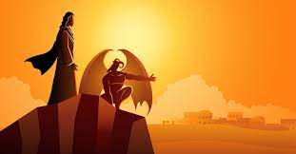
Satan’s Temptation of Christ
⁵ Then he led Jesus up [to a high mountain] and displayed before Him all the kingdoms of the inhabited earth [and their magnificence] in the twinkling of an eye. ⁶ And the devil said to Him, “I will give You all this realm and its glory [its power, its renown]; because it has been handed over to me, and I give it to whomever I wish. ⁷ Therefore if You worship before me, it will all be Yours.” ⁸ Jesus replied to him, “It is written and forever remains written, ‘You shall worship the Lord your God and serve only Him.’” Luke 4:5-8

Slide 17
Satan is the prince over the world
¹⁹ We know that we are of God, and the whole world lies under the sway of the wicked one. 1 John 5:19
³⁰ I will no longer talk much with you, for the ruler of this world is coming, and he has nothing in Me
John 14:30

Slide 18
Satan is Temptation Personified
⁸ Be [sober, be vigilant; because your adversary the devil walks about like a roaring lion, seeking whom he may devour. ⁹ Resist him, steadfast in the faith, knowing that the same sufferings are experienced by your brotherhood in the world. 1 Peter 5:8

Slide 19
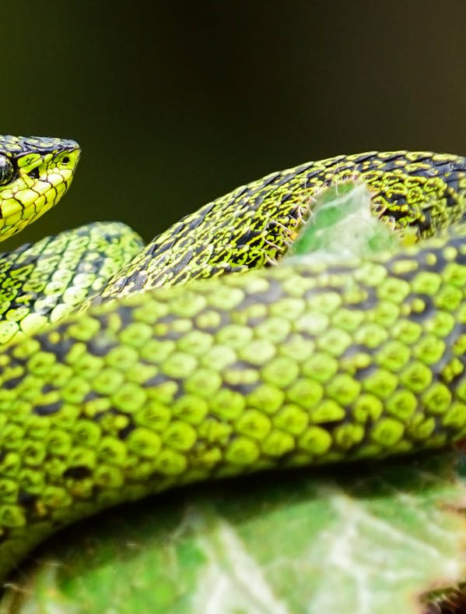
Satan is the father of lies.
He was a murderer from the beginning and does not stand in the truth because there is no truth in him. When he lies, he speaks what is natural to him, for he is a liar and the father of lies and half-truths. John 8:44b
…but you shall know the truth and the truth shall set you free! John 8:32

Slide 20
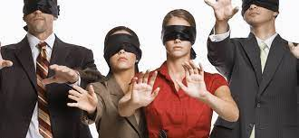
Satan Blinds
⁴ among them the god of this world [Satan] has blinded the minds of the unbelieving to prevent them from seeing the illuminating light of the gospel of the glory of Christ, who is the image of God. 2 Corinthians 4:4
I was blind but now I see…John 9:25

Slide 21
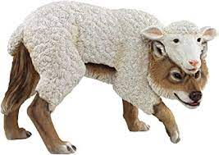
Satan is a chameleon!
2 Corinthians 11:13–15, “Even Satan disguises himself as an angel of light. So, it is not strange if his servants also disguise themselves as servants of righteousness.”
Beloved, do not believe every spirit [speaking through a self-proclaimed prophet]; instead test the spirits to see whether they are from God, because many false prophets and teachers have gone out into the world. 1 John 4:1

Slide 22
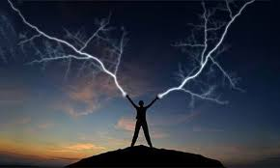
Satan Does Signs and Wonders
Matthew 24:24 “False Christs and false prophets will arise and show great signs and wonders, so as to lead astray, if possible, even the elect.
¹⁷ You therefore, beloved, since you know this beforehand, beware lest you also fall from your own steadfastness, being led away with the error of the wicked; ¹⁸ but grow in the grace and knowledge of our Lord and Savior Jesus Christ 2 Peter 3:17

Slide 23

Satan Steals Your Faith
“Satan immediately comes and takes away the word which was sown in them.” Mark 4:15
Satan snatches the word because he hates faith which the word produces (Romans 10:17).
Your Word I have hidden in my heart so that I do not sin against you. Psalms 119:11

Slide 24

Satan The Accuser
Revelation 12:10 says, “I heard a loud voice in heaven saying, ‘Now the salvation and the power and the kingdom of our God and the authority of his Christ have come, for the accuser of our brothers has been thrown down, who accuses them day and night before our God

Slide 25
Satan The Accuser
⁹ If we confess our sins, He is faithful and just to forgive us our sins and to cleanse us from all unrighteousness
1 John 1:9

Slide 26

Satan’s Rule is Judged by the Cross!!
³¹ Now is the judgment of this world; now the ruler of this world will be cast out. ³² And I, if I am ^{[e]}lifted up from the earth, will draw all peoples to Myself.
John 12:31

Slide 27
Satan’s Rule is Judged by the Cross!!
of judgment, because the ruler of this world is judged!
John 16:11

Slide 28
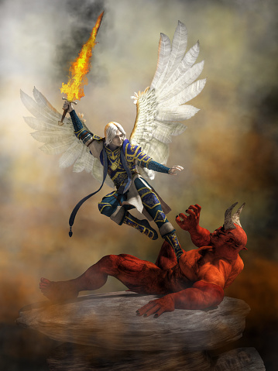
Satan Was Disarmed by the Cross
¹⁵ When He had disarmed the rulers and authorities [those supernatural forces of evil operating against us], He made a public example of them [exhibiting them as captives in His triumphal procession], having triumphed over them through ^{[i]}the cross. Colossians 2:15

Slide 29
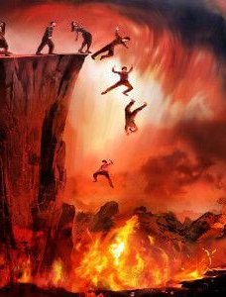
Satan’s Final Destination
¹⁰ And the devil who had deceived them was hurled into the lake of fire and burning brimstone (sulfur), where the beast (Antichrist) and false prophet are also; and they will be tormented day and night, forever and ever.
Revelation 20:10

Slide 30

REFLECTION & HOMEWORK

