Slide 1

Biblical Grounds For Divorce
Episode Three

Slide 2

Introduction
In episode one and two, we dealt with definitions of divorce, the difference between putting away and actual divorce and the context of Jesus’ comments on these matters in Matthew 5 and 19.

Slide 3

Introduction
In this episode, we will look at four biblical acceptable causes for divorce and the related scriptures to build on a more holistic scriptural view. We will see that even though God has a beautiful standard for marriage, He has made pastoral provision for human beings and their failings.

Slide 4


ABANDONMENT
¹³ And a woman who has a husband who does not believe, if he is willing to live with her, let her not divorce him. ¹⁴ For the unbelieving husband is sanctified by the wife, and the unbelieving wife is sanctified by the husband; otherwise your children would be unclean, but now they are holy. ¹⁵ But if the unbeliever departs, let him depart; a brother or a sister is not under bondage in such cases. But God has called us to peace.

Slide 5
ABANDONMENT
But if those who are not believers decide to ·leave [or divorce], let them ·leave [or divorce]. When this happens, the ·Christian man [^{L} brother] or ·woman [^{L} sister] is ·free [^{L} not bound; ^{C} to the marriage covenant]. But God called us to ·live in peace [^{L} peace].
1Corinthians 7:15 EXB

Slide 6
ABANDONMENT
The scriptures here are clear; if the non Christian spouse pushes for a divorce or termination of the marriage, they should not be forced against their wish.
Paul then goes on to say the divorced believer is no longer bound to that marriage.
What Paul by the Spirit then says later in the same passage is very interesting

Slide 7


ABUSE

Slide 8
^{ABUSE}
⁷ “And if a man sells his daughter to be a female slave, she shall not go out as the male slaves do. ⁸ If she ^{[b]}does not please her master, who has betrothed her to himself, then he shall let her be redeemed. He shall have no right to sell her to a foreign people, since he has dealt deceitfully with her. ⁹ And if he has betrothed her to his son, he shall deal with her according to the custom of daughters. ¹⁰ If he takes another wife, he shall not diminish her food, her clothing, and her marriage rights. ¹¹ And if he does not do these three for her, then she shall go out free, without paying money.

Slide 9
^{ABUSE}
God was against the neglect and abuse of a vulnerable spouse and mandated that at a bear minimum, a Husband was to care for his Wife in these three key areas
Food – literally meaning her flesh
Clothing – protection and covering
Conjugal rights – literally meaning sex

Slide 10
^{ABUSE}
A slave bought could not just go free without making a payment for their freedom. In this case, the down payment for this slave Wife acted as her dowry if she decided to separate or be divorced from her abusive, neglecting Husband. She would go free without payment

Slide 11
^{ABUSE}
¹⁰ “When you go out to war against your enemies, and the Lord your God delivers them into your hand, and you take them captive, ¹¹ and you see among the captives a beautiful woman, and desire her and would take her for your wife, ¹² then you shall bring her home to your house, and she shall shave her head and trim her nails. ¹³ She shall put off the clothes of her captivity, remain in your house, and mourn her father and her mother a full month; after that you may go into her and be her husband, and she shall be your wife. ¹⁴ And it shall be, if you have no delight in her, then you shall set her free, but you certainly shall not sell her for money; you shall not treat her brutally, because you have humbled her.
Deuteronomy 21:10-14

Slide 12
^{ABUSE}
In this case the Husband could set his Wife free even though there is no case of immorality involved here.
This is perhaps closer to the Abraham and Hagar scenario where Abraham sends a reluctant Hagar away with his son even though she had committed no crime.
The apparent compensation here is Freedom for the Wife who was a slave, then became the Master’s Wife and then becomes a Free Divorced Woman.

Slide 13
^{ABUSE}
It is good for a man not to touch a woman. ² Nevertheless, because of sexual immorality, let each man have his own wife, and let each woman have her own husband. ³ Let the husband render to his wife the affection due her, and likewise also the wife to her husband. ⁴ The wife does not have authority over her own body, but the husband does. And likewise, the husband does not have authority over his own body, but the wife does. ⁵ Do not deprive one another except with consent for a time, that you may give yourselves to fasting and prayer; and come together again so that Satan does not tempt you because of your lack of self-control. ⁶ But I say this as a concession, not as a commandment.
1 Corinthians 7:1-6

Slide 14
^{ABUSE}
This spirit of these verses of scripture make it clear that with sustained, consistent abuse, neglect and malevolent behavior in marriage, there are grounds for separation or divorce.
Good godly but brave Shepherds and Pastors need to help couples stay in and within their marriage vows. These same Leaders need to be bold to help support the vulnerable out of a marriage that does not honor God and falls within these parameters of neglect and abuse.
There can be no hard and fast rule here, but Pastors need to hear the Holy Spirit guide in these circumstances each with its own unique presentation.

Slide 15
^{ABUSE}
⁸ But if anyone does not provide for his own, and especially for those of his household, he has denied the faith and is worse than an unbeliever.
1 Timothy 5:8

Slide 16
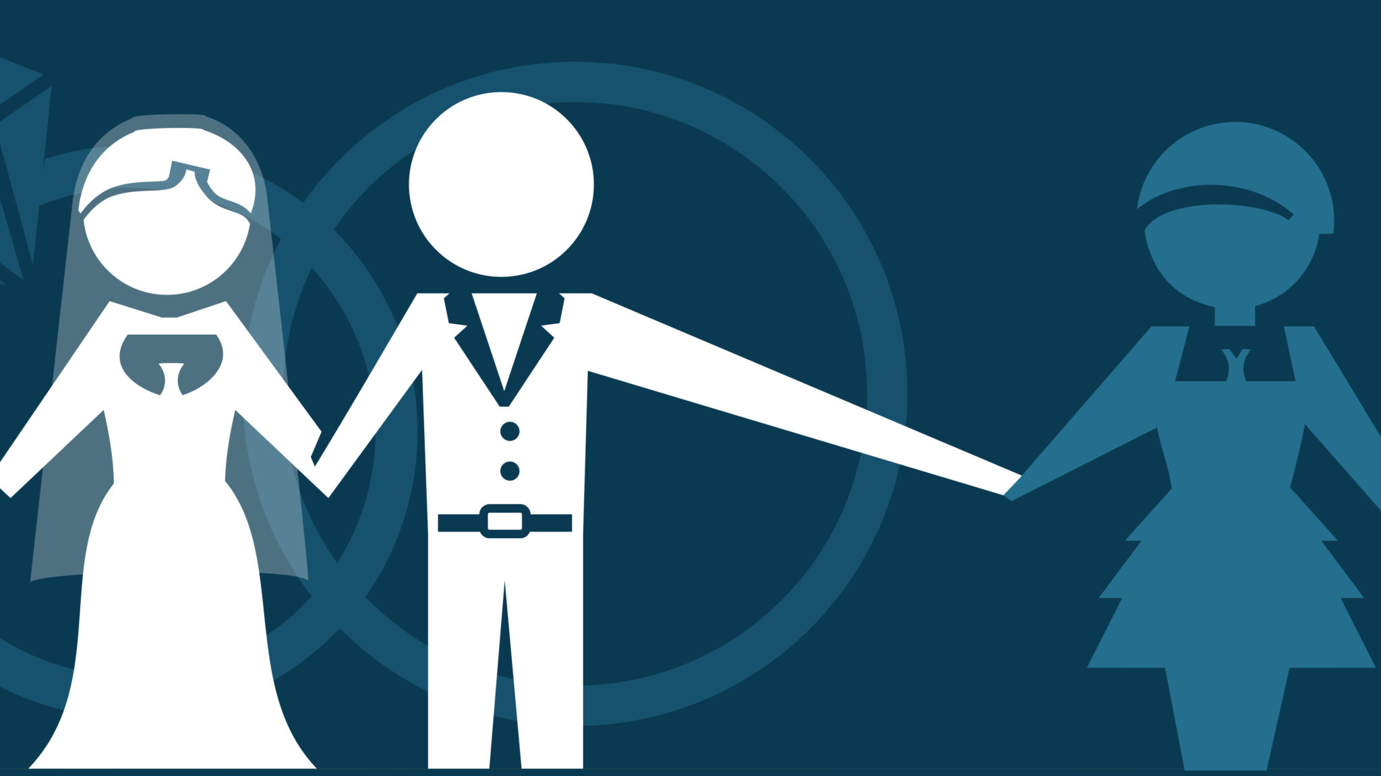
‘ADULTERY’

Slide 17
‘ADULTERY’
But I say unto you, that whosoever shall put away his wife, except for cause of fornication, makes her commit adultery, and whosoever marries one that is put away commits adultery
Matthew 5:32

Slide 18
‘ADULTERY’
The word translated fornication, adultery, sexual immorality is - Porneia
Now we must ask about this Greek word porneia (πορνεία) – Strong’s G4202, which is translated as fornication. Porneia can, according to Thayer’s Bible Dictionary, incorporate a variety of illicit sexual behaviors which include not only adultery but incest, homosexuality, and bestiality, as listed in Leviticus 18

Slide 19
‘ADULTERY’
If a man seduces a virgin who is not betrothed and lies with her, he shall give the bride-price for her and make her his wife. If her father utterly refuses to give her to him, he shall pay money equal to the bride-price for virgins (Exodus 22:16-17).
If a man meets a virgin who is not betrothed, and seizes her and lies with her, and they are found, then the man who lay with her shall give to the father of the young woman fifty shekels of silver, and she shall be his wife, because he has violated her. He may not divorce her all his days (Deuteronomy 22:28-29).

Slide 20
‘ADULTERY’
Exodus 22 is an example of a man who seduces an unbetroth virgin and has sexual intercourse with her (“lies with her”). The case here seems to be consensual on the woman’s part (the man “seduces” her), whereas Deuteronomy 22 uses stronger language (“seizes her,” “violated her”) and may refer to rape. Either way, the Exodus passage requires the man to marry the woman he had sex with, unless the father of the woman absolutely refuses the marriage. In this case, the marriage is annulled, and the man must still pay the bride-price for the woman as compensation, as the woman’s marriage value has diminished since she is no longer a virgin. The Deuteronomy passage does not mention the father’s option of refusal but rather requires the man to pay the bride-price and marry the woman and never divorce her.

Slide 21
‘ADULTERY’
According to McIlhaney and Bush, when a woman is touched in a loving way, her brain secretes oxytocin, which activates feelings of closeness and trust. Breastfeeding has a similar effect, encouraging mommy-baby bonding. More intimate physical contact produces more oxytocin, which leads to a greater desire for that close feeling.

Slide 22
‘ADULTERY’
Oxytocin production, like dopamine, is not controlled by conscience or consciousness, but is a physiological effect of intimate contact. When this is experienced outside the commitment of marriage, the authors noted that women can become deceived into thinking a bad relationship is good because of the effects of touch-dependent oxytocin. And when that relationship ends, the broken bond and feelings of betrayal of trust can lead to severe emotional trauma.
For men, an effect of vasopressin—which floods a man’s brain during intercourse—is that it leads to a bonded feeling with his partner. Research shows that if he has intercourse with multiple partners, the bonded feeling is dissipated, eventually imperilling a man’s ability to form long-term attachments.

Slide 23
‘ADULTERY’
¹⁵ Do you not know that your bodies are members of Christ? Shall I then take the members of Christ and make them members of a harlot? Certainly not! ¹⁶ Or do you not know that he who is joined to a harlot is one body with her? For “the two,” He says, “shall become one flesh.” ¹⁷ But he who is joined to the Lord is one spirit with Him.
¹⁸ Flee sexual immorality. Every sin that a man does is outside the body, but he who commits sexual immorality sins against his own body. ¹⁹ Or do you not know that your body is the temple of the Holy Spirit who is in you, whom you have from God, and you are not your own?
I Corinthians 6:15-19

Slide 24

DEATH

Slide 25
^{DEATH}
³ and if the latter husband turns against her and writes her a certificate of divorce, puts it in her hand, and sends her out of his house, or if the latter husband dies who took her as his wife,
Deuteronomy 24:3

Slide 26
^{DEATH}
³⁹ A wife is bound by law as long as her husband lives; but if her husband dies, she is at liberty to be married to whom she wishes, only in the Lord.
1 Corinthians 7:39

Slide 27
CONCLUSION
The Bible states in various scriptures that God’s design for Marriage is between a Man and Woman for life.
God has made provision for man’s failure in marriage like He did for Adam and Eve and the whole of mankind for sin.
Divorce is NOT God’s perfect Will but He is able to help people beyond their mistakes and the mistakes of spouses in marriage.

Slide 28
CONCLUSION
In the Bible, Divorce is permitted on the grounds of
Abandonment
Abuse
‘Adultery’
Death

